Slide 1
Configuration Guide
(JDK – JDK 6 Update 14)
2009. 07. 21
CODELABOR

Slide 2
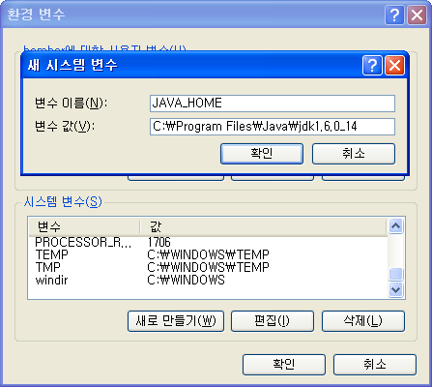
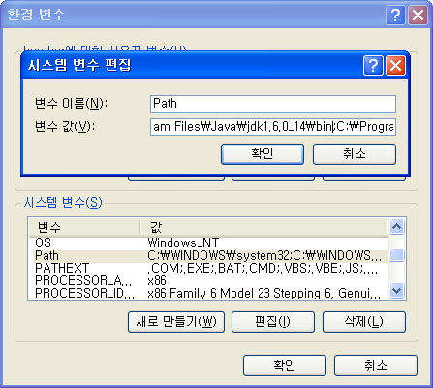
JDK
Environment Variable
Environment Variable
  Set JAVA_HOME: C:\Program Files\Java\jdk1.6.0_14
  Add PATH: C:\Program Files\Java\jdk1.6.0_14\bin

Slide 3
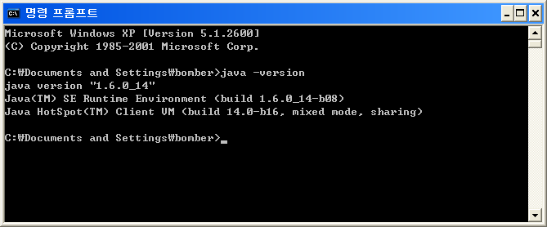
JDK
Version Check
Version
  Execute java –version

Slide 4
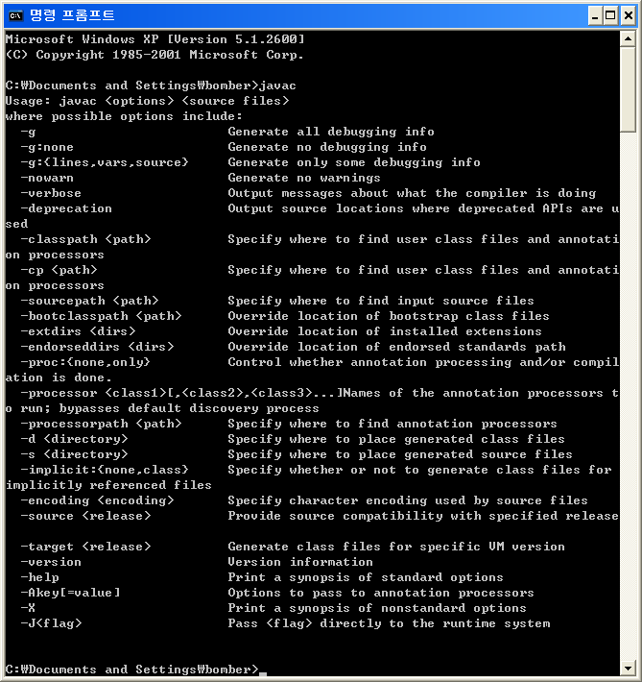
JDK
Path
Path
  Execute javac

